Slide 1

Lesson 5 CN4003: More HTML & CSS
Dr Fadi Safieddine
1
Dr. Fadi Safieddine copyright 2021

Slide 2
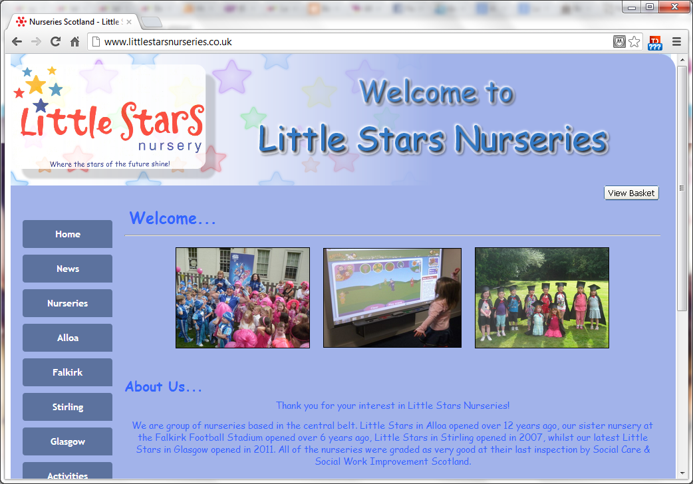
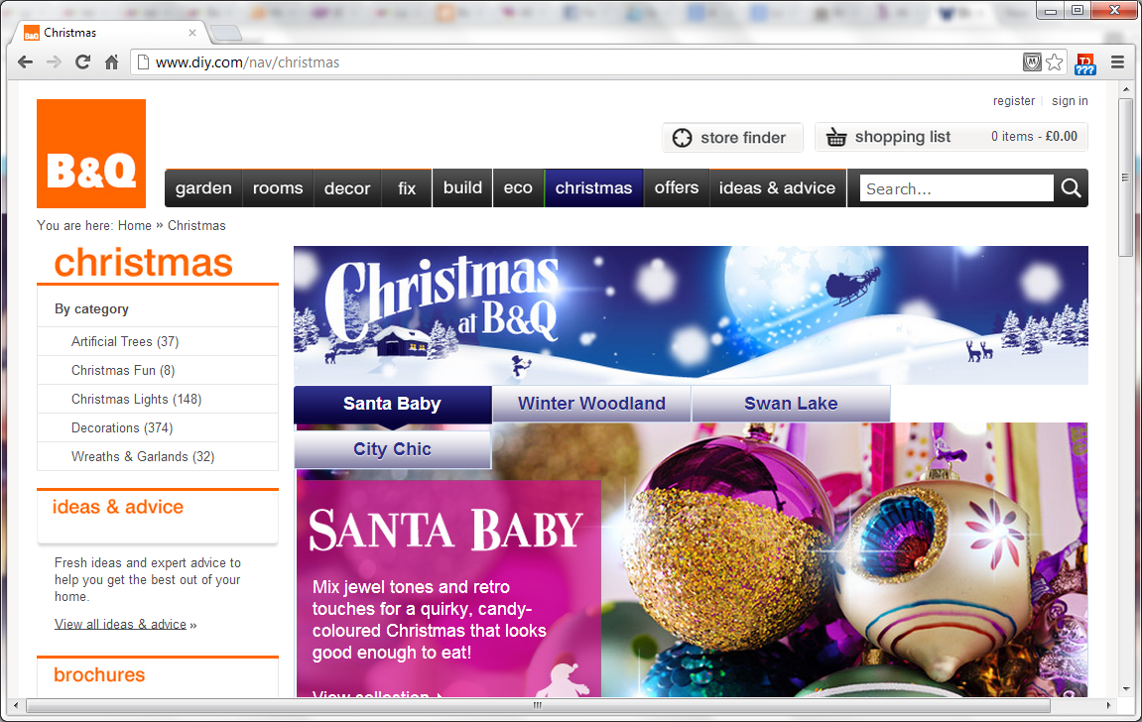
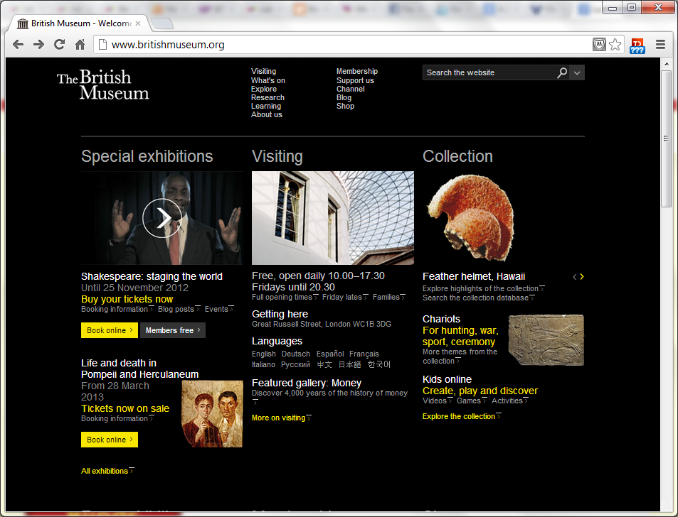
Lecture content
Before we start (Quick Recap)
Images with CSS:
Controlling size of images.
Image alignments
Centring images
Aligning images
Shorthand backgrounds
Review of CSS related codes with HTML:
Boxes (layout)
Lists
Talk about the assignment.
2

Slide 3
Quick Recap
Week 2: We learned HTML and Basic CSS
Week 3: We learned further CSS, specifically use of ‘Class’, creating tables and forms.
Week 4: Had a break to focus on planning the website.
Week 5: We continue programming.

Slide 4
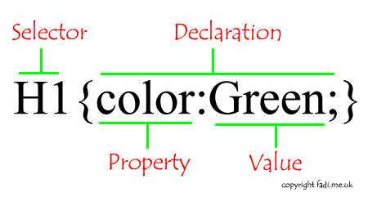
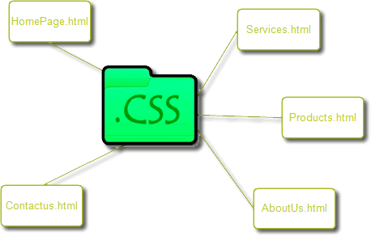
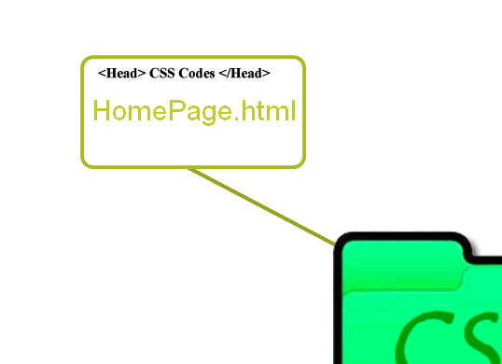
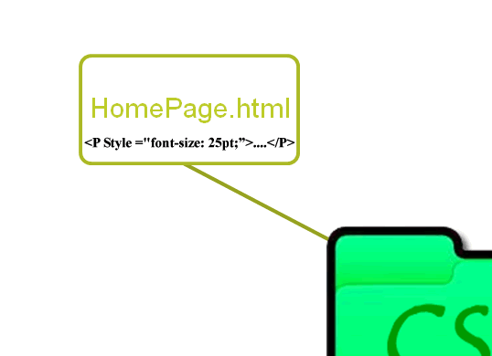
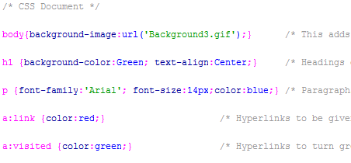
Quick recap
1. External 2. Embedded 3. Inline
4

Slide 5
Control image sizes using CSS:
img.large { width: 500px; height: 500px;}
img.medium { width: 250px; height: 250px;} img.small { width: 100px; height: 100px;}

Slide 6
Control image sizes using CSS:
img.large { width: 500px; height: 500px;}
img.medium { width: 250px; height: 250px;} img.small { width: 100px; height: 100px;}

Slide 7
Control image sizes using CSS:
img.large { width: 500px; height: 500px;}
img.medium { width: 250px; height: 250px;} img.small { width: 100px; height: 100px;}

Slide 8
Control image sizes using CSS:
img.large { width: 500px; height: 500px;}
img.medium { width: 250px; height: 250px;} img.small { width: 100px; height: 100px;}

Slide 9
Control image sizes using CSS:
img.large { width: 500px; height: 500px;}
img.medium { width: 250px; height: 250px;} img.small { width: 100px; height: 100px;}

Slide 10
Control image sizes using CSS:
img.large { width: 500px; height: 500px;}
img.medium { width: 250px; height: 250px;} img.small { width: 100px; height: 100px;}

Slide 11
Control image sizes using CSS:
img.large { width: 500px; height: 500px;}
img.medium { width: 250px; height: 250px;} img.small { width: 100px; height: 100px;}

Slide 12
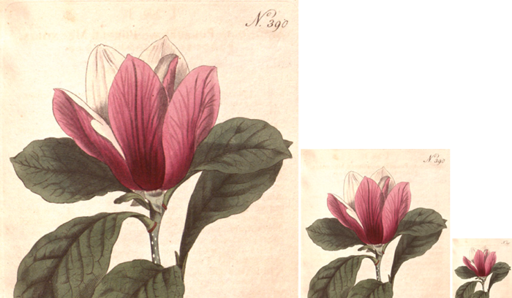

Slide 13
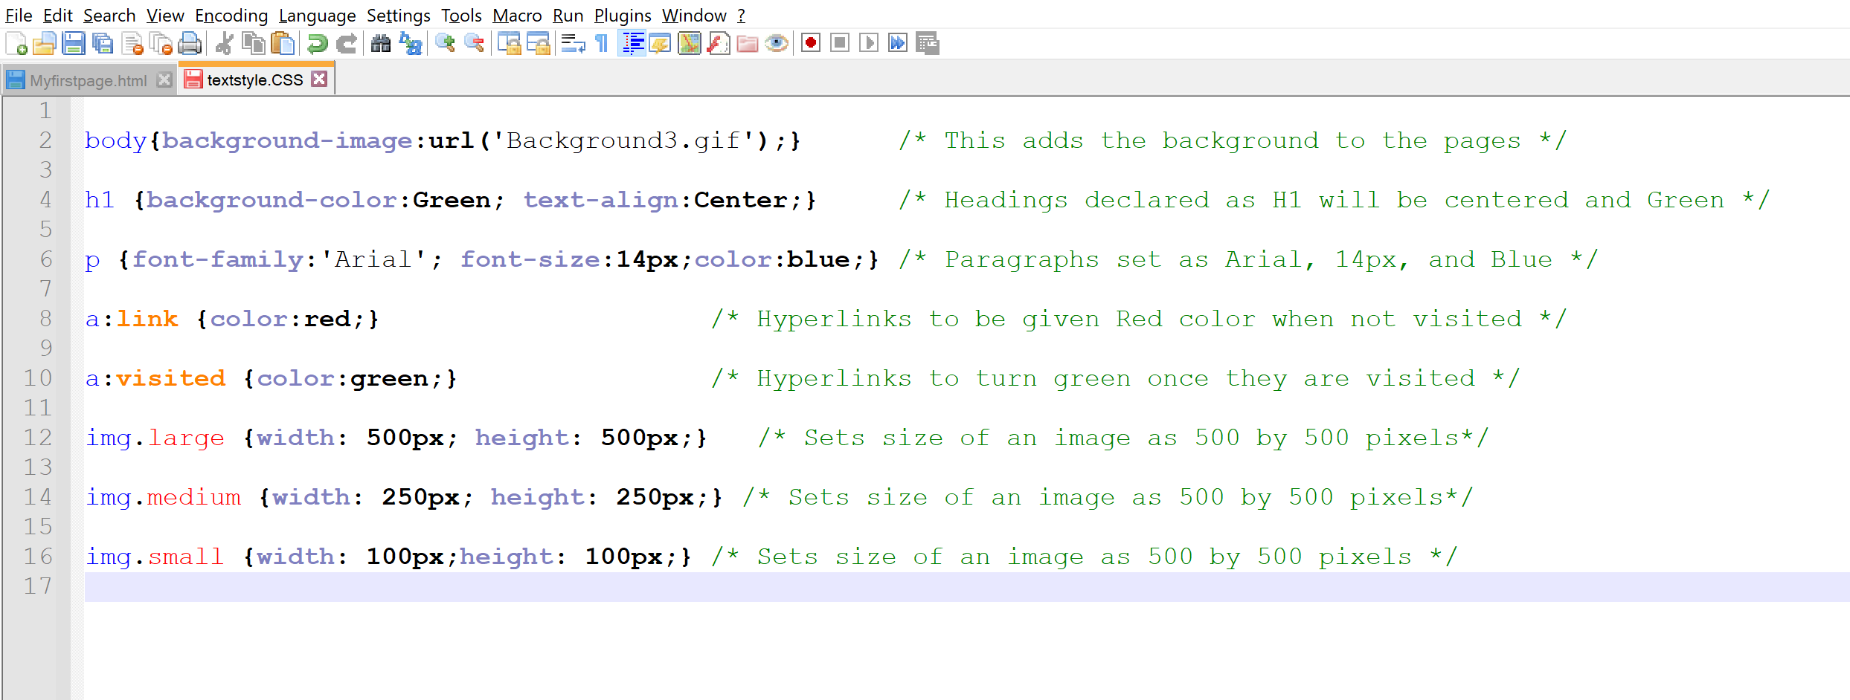
Demonstration of application

Slide 14
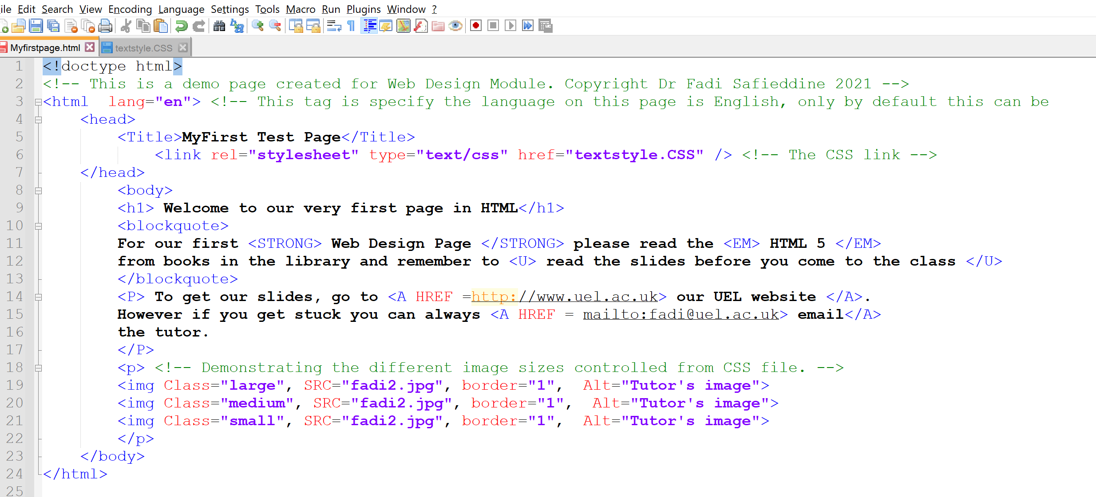
Demonstration of application

Slide 15
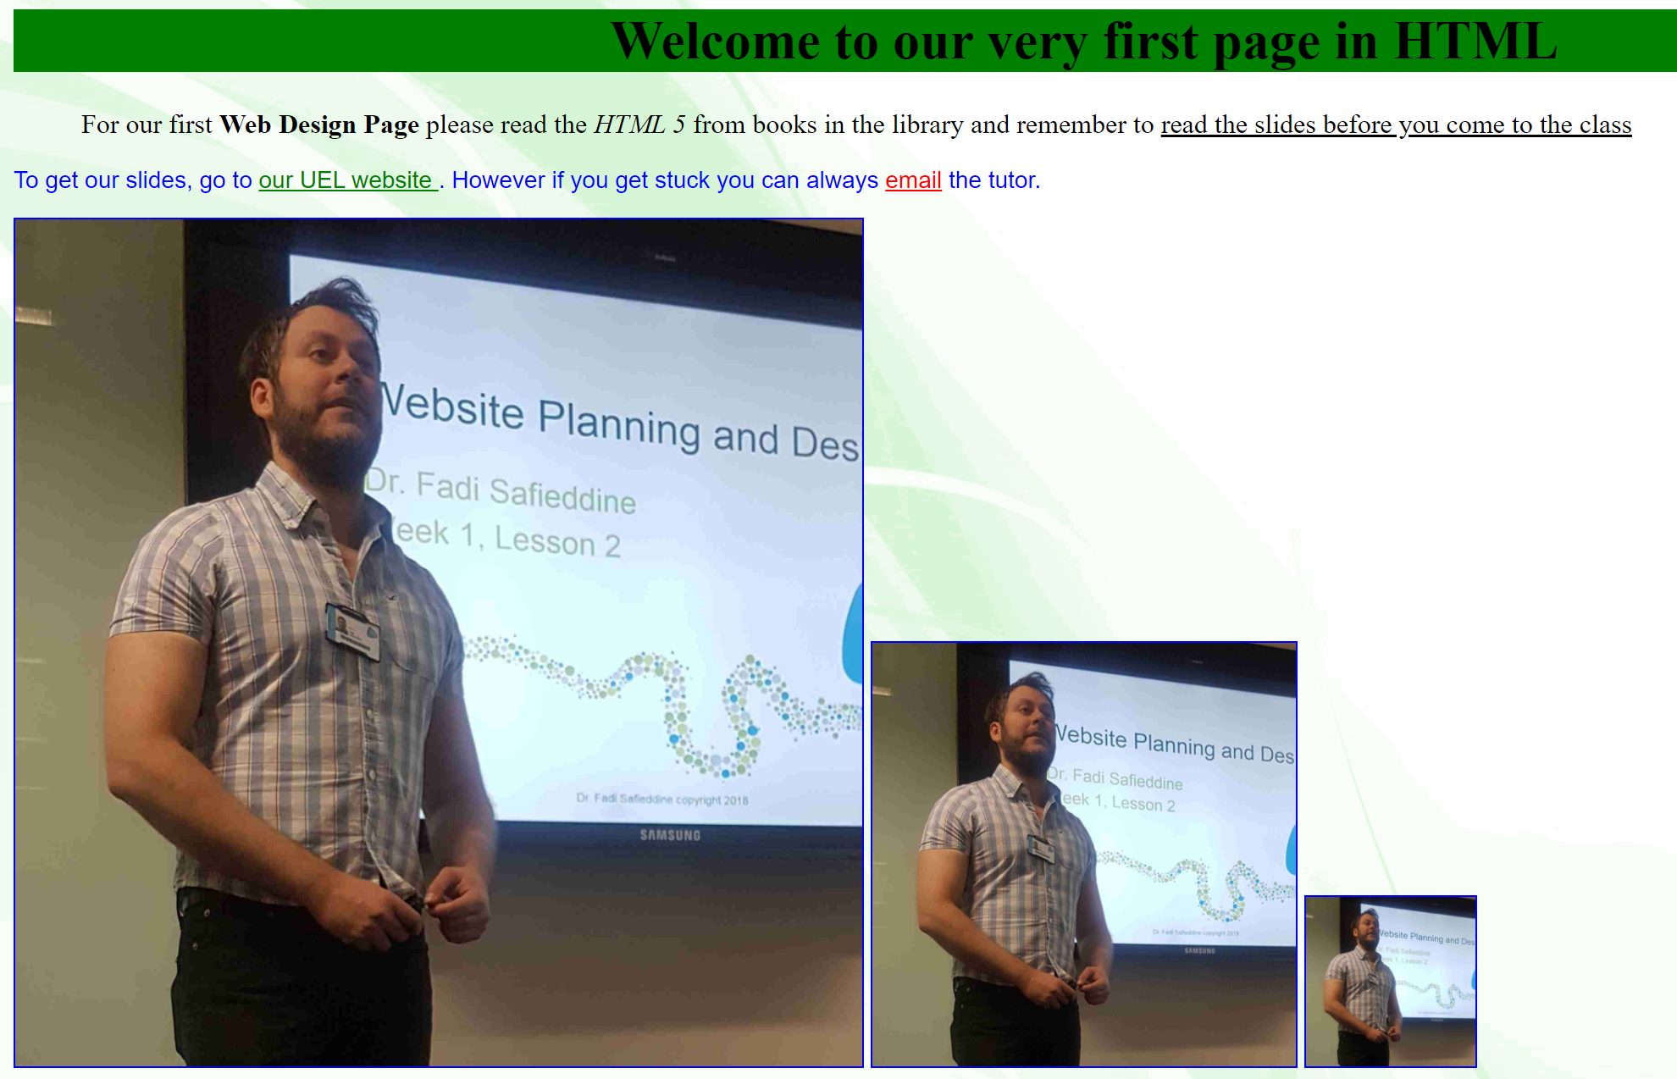
Demonstration of application

Slide 16
End of Part 1
Lab Practice 5.1. Take the time to edit any of the first HTML pages you created and do the following:
Edit the CSS file with the different image sizes.
Edit the HTML to have three images instead of one.
Add the different image sizes classes to the images.
Save it to be uploaded with the remaining practices part of the lab engagement.

Slide 17
Align images using CSS:
Part 2
Notes:
Note: It's important to create a gap between text and pictures.

Slide 18

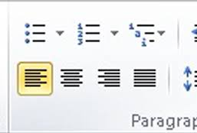
What is ‘align’?
Left Centre Right

Slide 19
Align images using CSS:
img.align-left { float: left; margin-right: 10px;}
img.align-right { float: right; margin-left: 10px;}
Notes:
Note: It's important to create a gap between text and pictures.

Slide 20
Align images using CSS:
img.align-left { float: left; margin-right: 10px;}
img.align-right { float: right; margin-left: 10px;}

Slide 21
Align images using CSS:
img.align-left { float: left; margin-right: 10px;}
img.align-right { float: right; margin-left: 10px;}

Slide 22
Align images using CSS:
img.align-left { float: left; margin-right: 10px;}
img.align-right { float: right; margin-left: 10px;}

Slide 23
Align images using CSS:
img.align-left { float: left; margin-right: 10px;}
img.align-right { float: right; margin-left: 10px;}

Slide 24
Align images using CSS:
img.align-left { float: left; margin-right: 10px;}
img.align-right { float: right; margin-left: 10px;}

Slide 25
Align images using CSS:
img.align-left { float: left; margin-right: 10px;}
img.align-right { float: right; margin-left: 10px;}

Slide 26
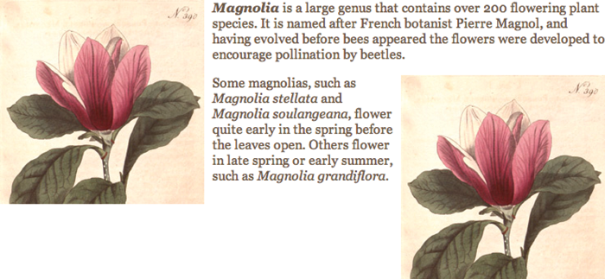

Slide 27
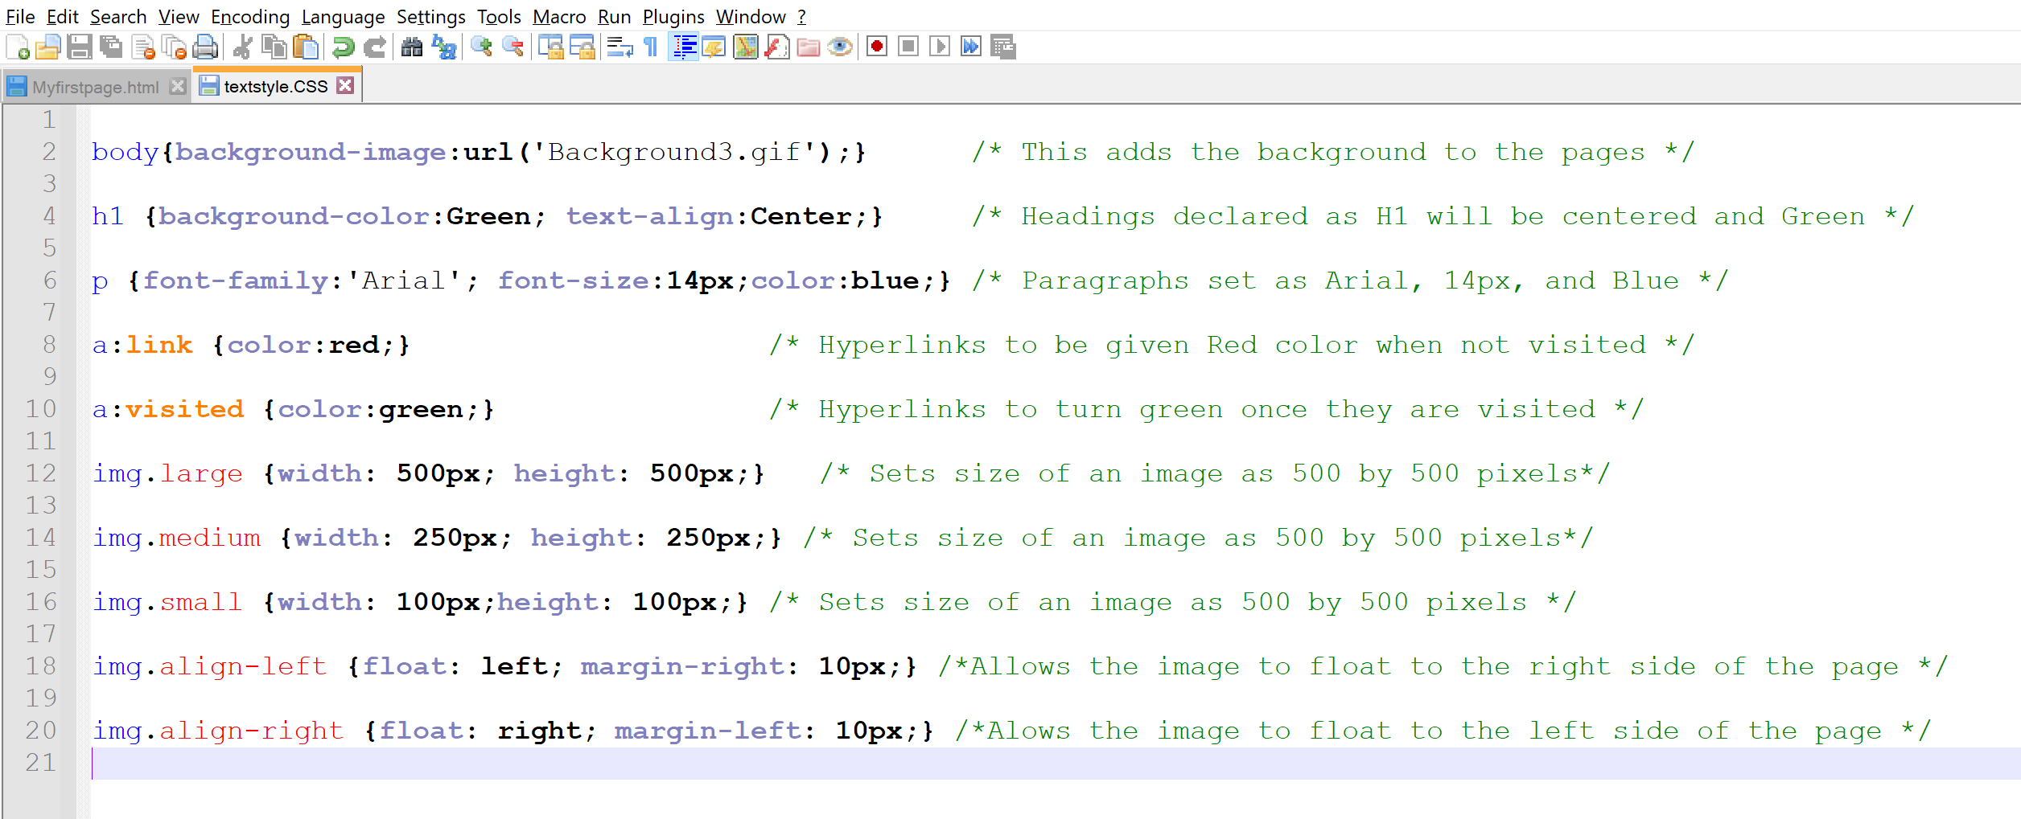
Demonstration of application

Slide 28
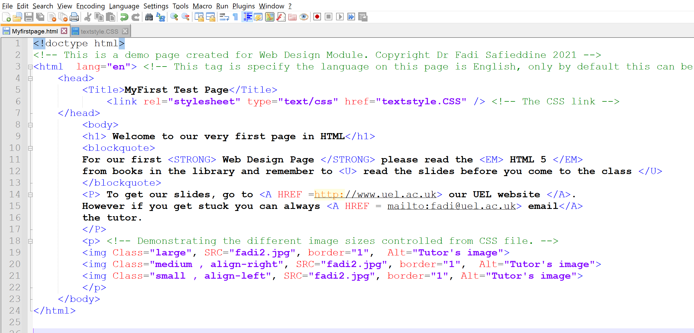
Demonstration of application

Slide 29
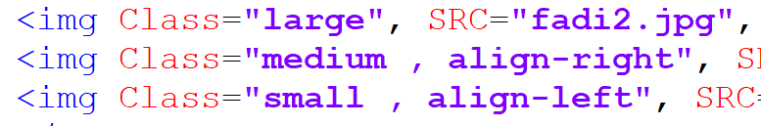
Demonstration of application
Note how we can call multiple classes to the HTML document.

Slide 30
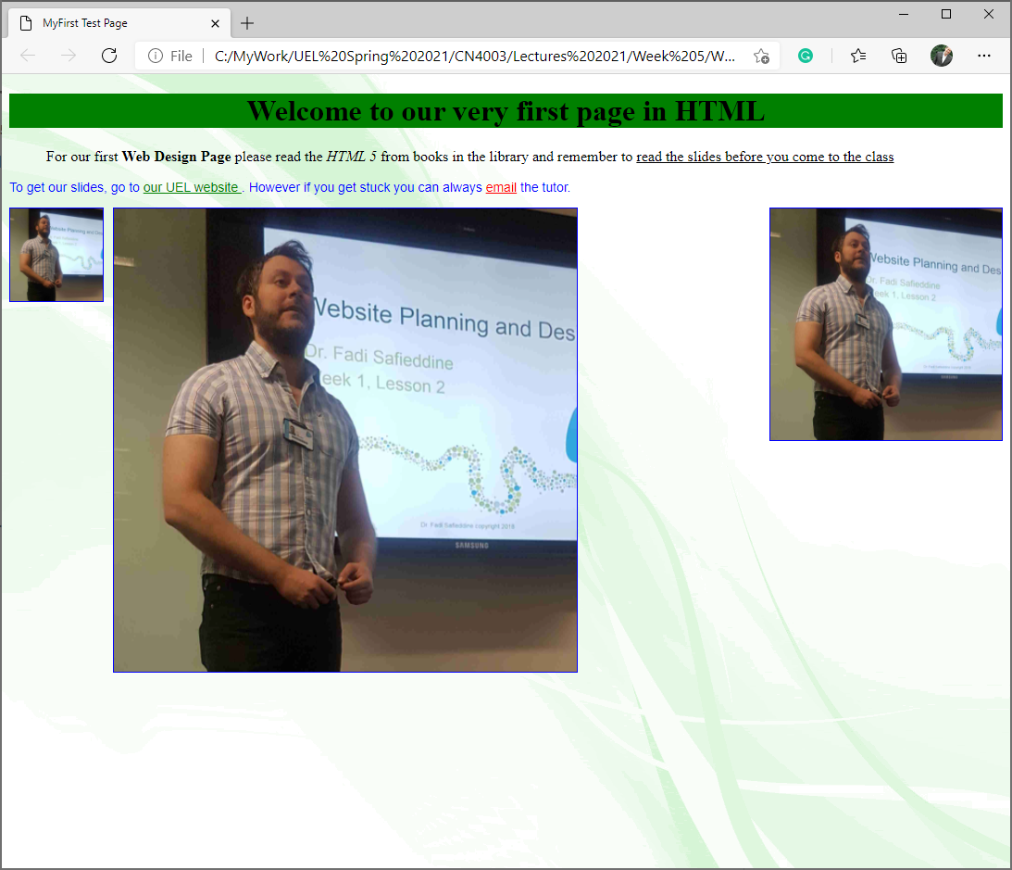
Demonstration of application

Slide 31
End of Part 2
Lab Practice 5.2. Edit the same page you created earlier with the three images
Edit the CSS file with the different alignments.
Add the different alignment classes to the images.
Save it to be uploaded with the remaining practices part of the lab engagement.

Slide 32
Centering images using CSS:
Part 3

Slide 33
Centering images using CSS:
Part 3
img.align-center { display: block; margin: 0px auto;}

Slide 34
Centering images using CSS:
img.align-center { display: block; margin: 0px auto;}
Notes:
Display property needs to be added here to center the image.

Slide 35
Centering images using CSS:
img.align-center { display: block; margin: 0px auto;}
Notes:
Margin property needs to be auto for left and right margins.

Slide 36
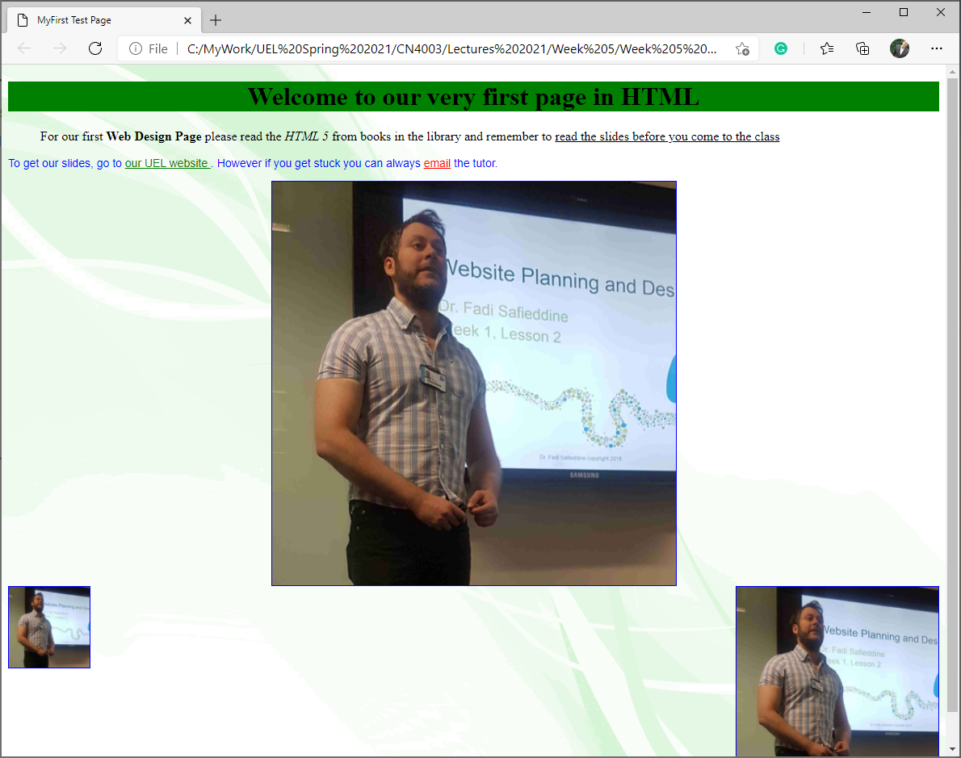
With block and centred

Slide 37
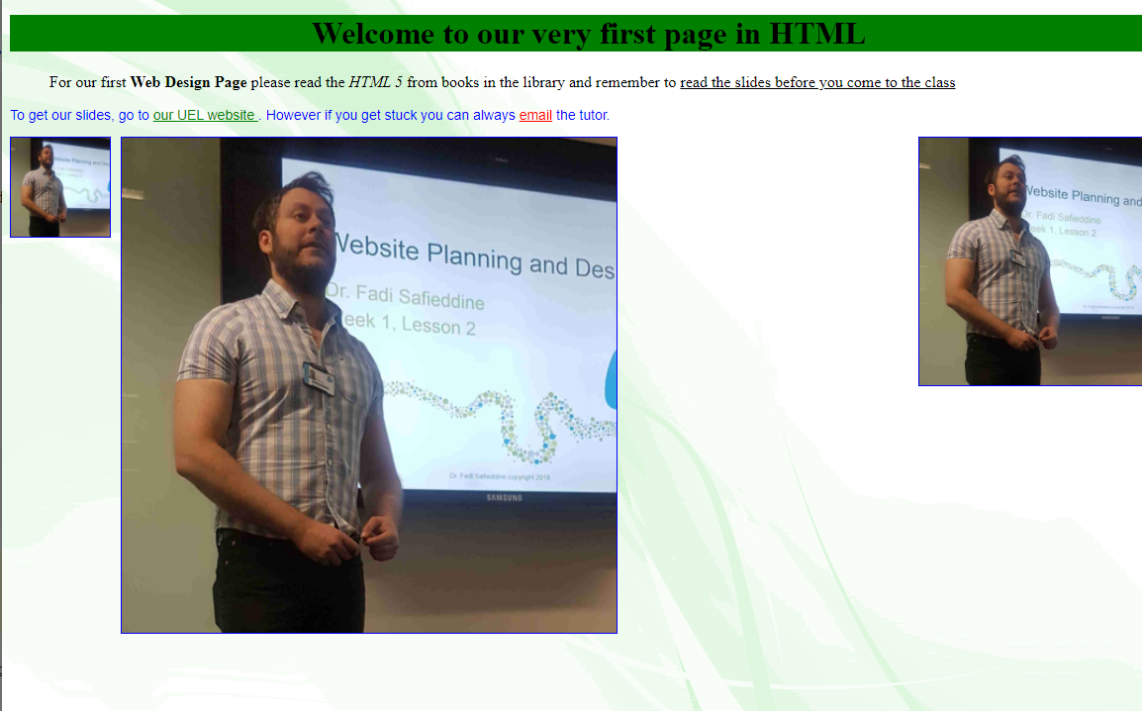
Without block and centred

Slide 38
Backgrounds:
body { background: #ffffff url("images/ tulip.gif") no-repeat top right;}
Notes:
Need to specify in following order (but any can be missed)
1: background-color2: background-image3: background-repeatNOTE: background-attachment would be next (not used here)
5: background-position

Slide 39
Backgrounds:
body { background: #ffffff url("images/ tulip.gif") no-repeat top right;}
Notes:
Need to specify in following order (but any can be missed)
1: background-color2: background-image3: background-repeatNOTE: background-attachment would be next (not used here)
5: background-position

Slide 40
Backgrounds:
body { background: #ffffff url("images/ tulip.gif") no-repeat top right;}
Notes:
Need to specify in following order (but any can be missed)
1: background-color2: background-image3: background-repeatNOTE: background-attachment would be next (not used here)
5: background-position

Slide 41
Backgrounds:
body { background: #ffffff url("images/ tulip.gif") no-repeat top right;}
Notes:
Need to specify in following order (but any can be missed)
1: background-color2: background-image3: background-repeatNOTE: background-attachment would be next (not used here)
5: background-position

Slide 42
Backgrounds:
body { background: #ffffff url("images/ tulip.gif") no-repeat top right;}
Notes:
Need to specify in following order (but any can be missed)
1: background-color2: background-image3: background-repeatNOTE: background-attachment would be next (not used here)
5: background-position

Slide 43
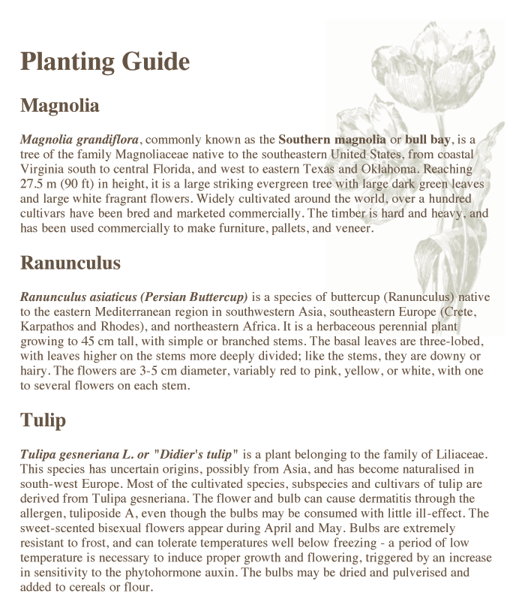

Slide 44
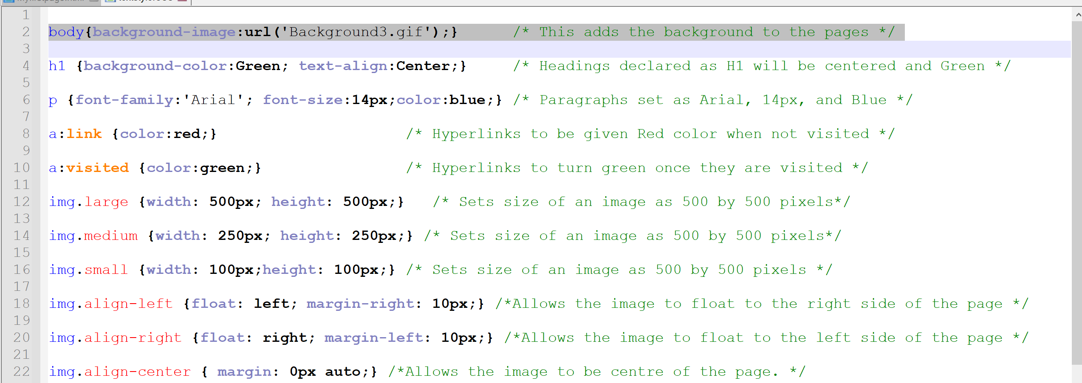
Demonstration of application
Remember to remove the old background first.

Slide 45
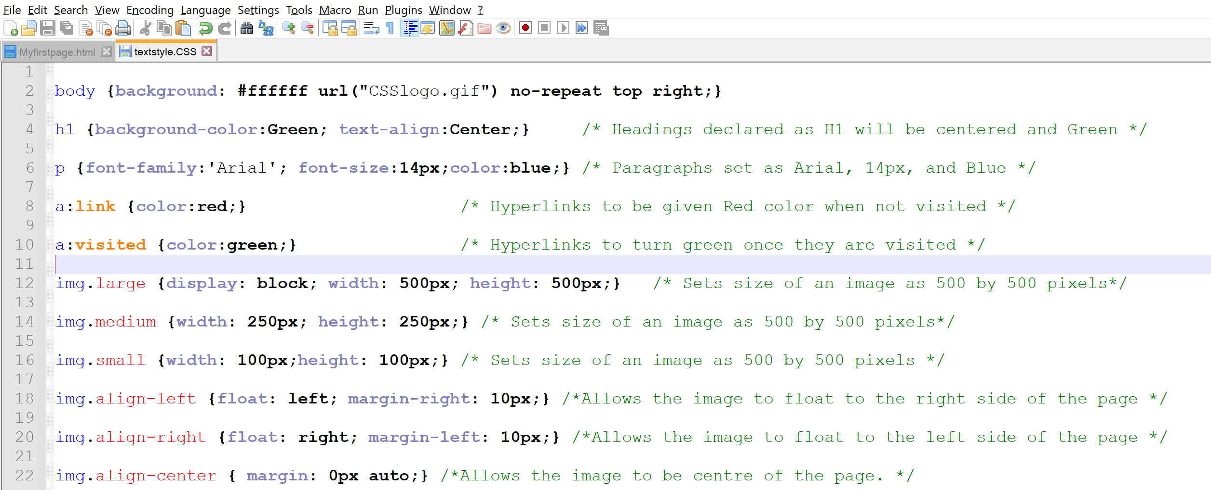
Demonstration of application

Slide 46
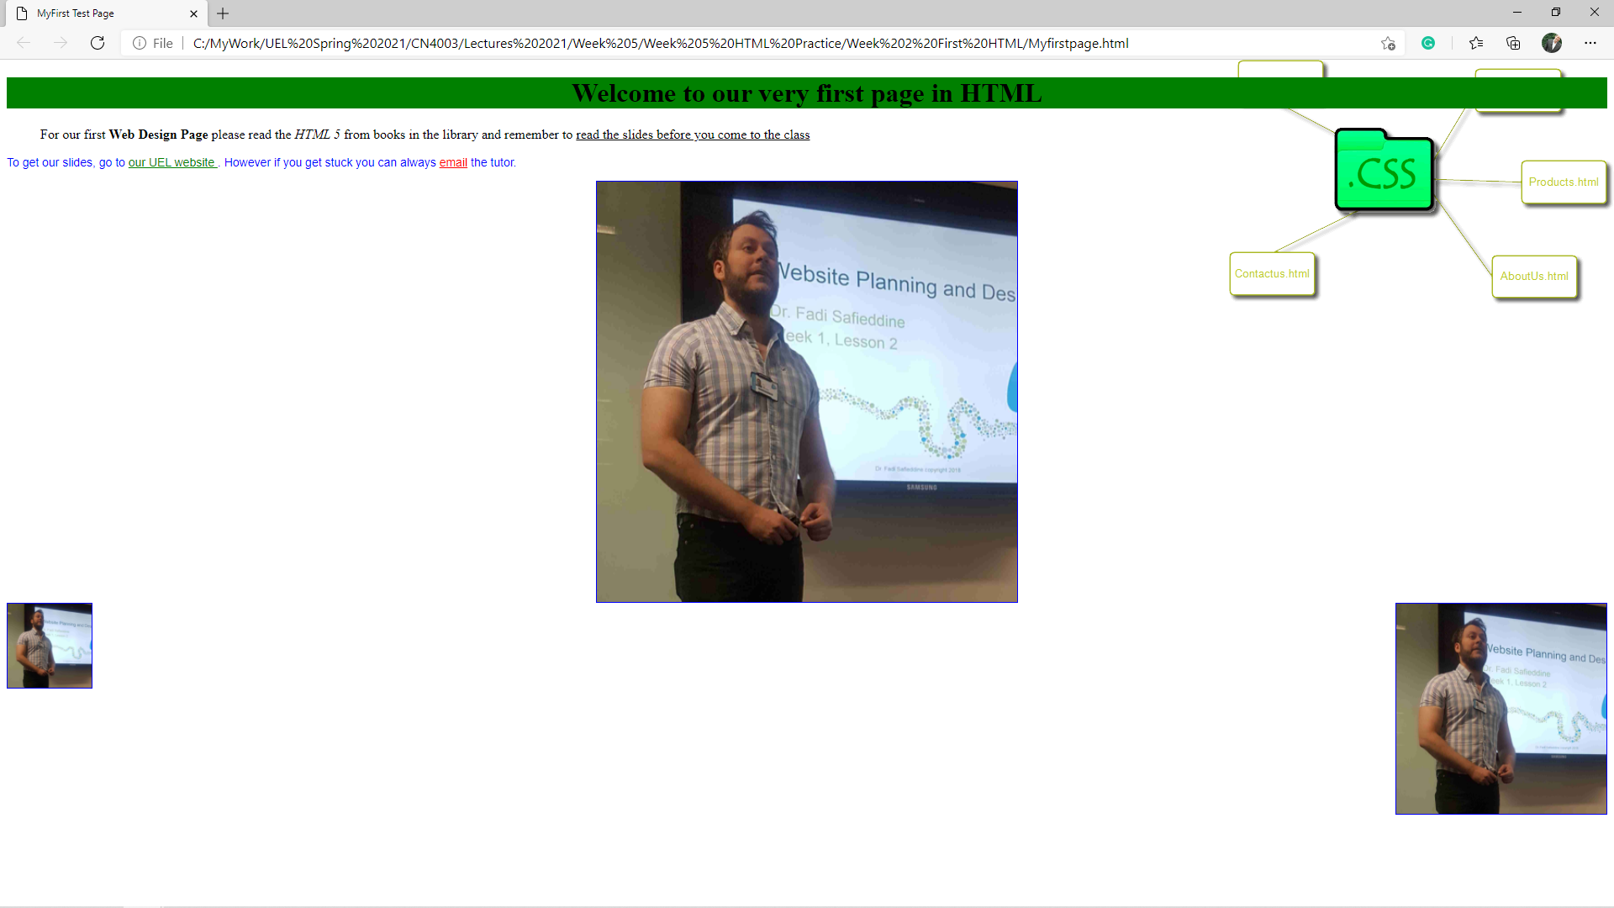
Demonstration of application

Slide 47
End of Part 3
Lab Practice 5.3. Follow these steps
Edit the background to include a floating image (any image of your choice).

Slide 48
Divs in Web design:
Part 4

Slide 49
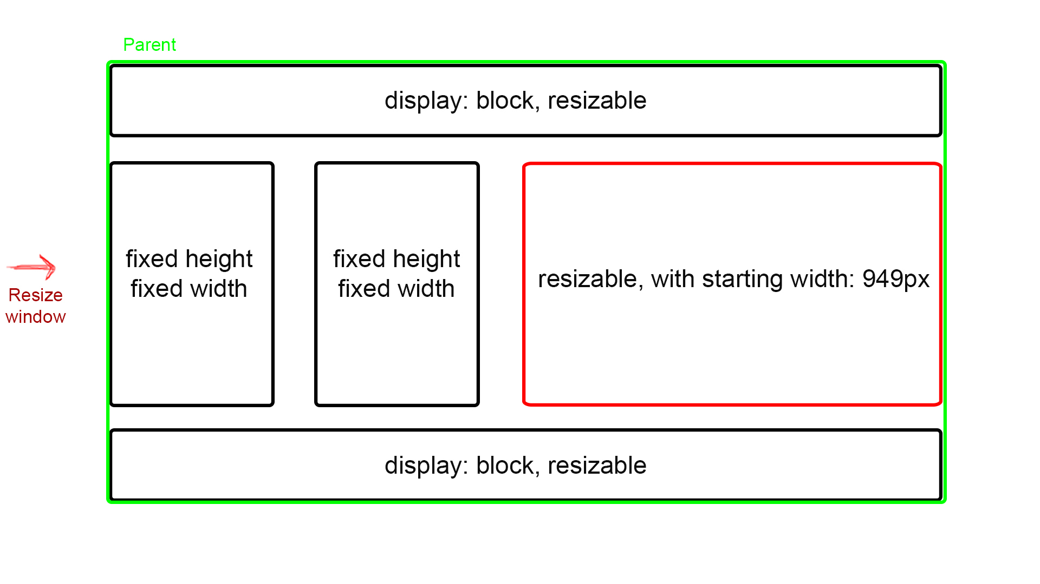
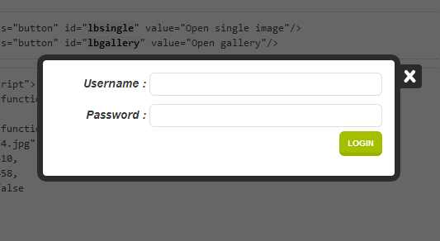
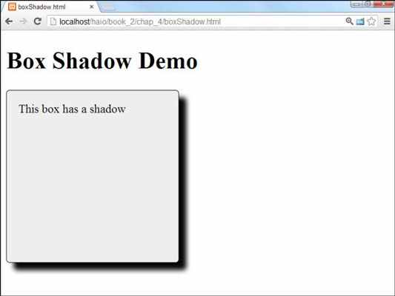
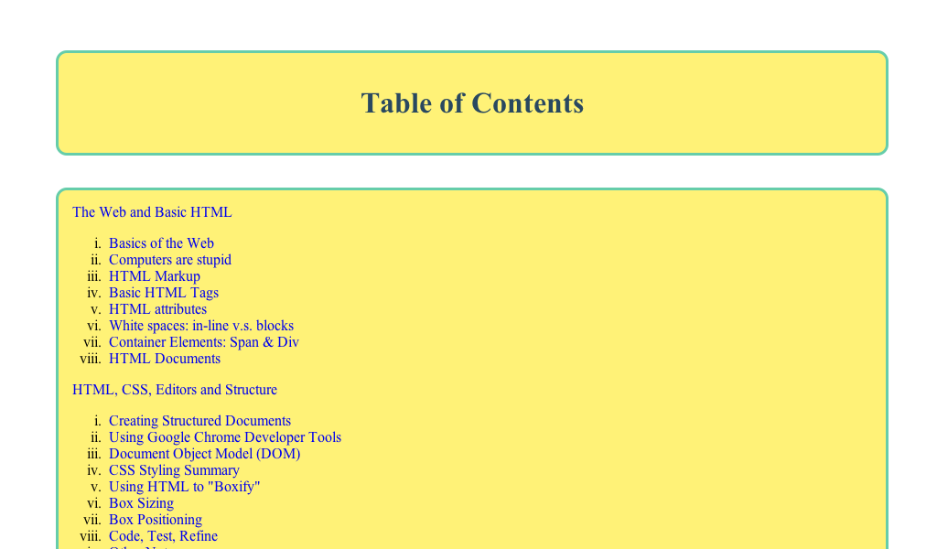
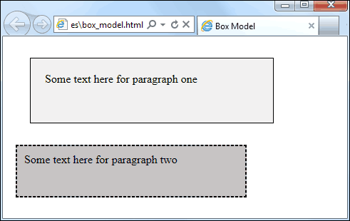
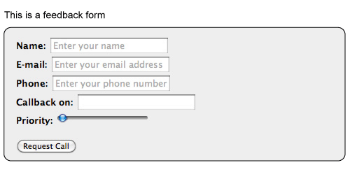
Divs in Web design:
We already learned them but we will go into more details:
Floating div
For layout design : Note
you can have fixed and
resizable boxes.

Slide 50
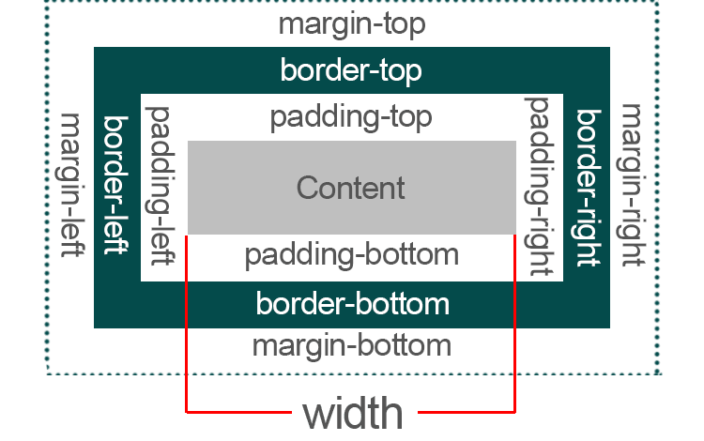
Boxes in Web design:
Important terms when it comes to boxes

Slide 51
Boxes in Web design:
What does these terms mean?
Margin: The distance between the box and everything else.
Border: The line that surrounds the box. You can make it thin, thick, set colour to it, or make it invisible.
Padding: The space you set between the border and the text inside the box.
Content: The text, image, or video you put inside the box.
Code: div{…}

Slide 52
Boxes in Web design:
What will this CSS code do?
div { width: 300px; border: 25px solid green; padding: 25px; margin: 25px; }

Slide 53
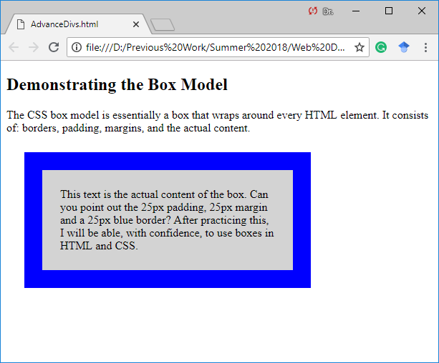
Now Practice this:
<!DOCTYPE html>
<html>
<head>
<style>
div {
background-color: lightgrey;
width: 300px;
border: 25px solid blue;
padding: 25px;
margin: 25px;
}
</style>
</head>
<body>
<h2>Demonstrating the Box Model</h2>
<p>The CSS box model is essentially a box that wraps around every HTML element. It consists of: borders, padding, margins, and the actual content.</p>
<div>This text is the actual content of the box. Can you point out the 25px padding, 25px margin and a 25px blue border? After practicing this, I will be able, with confidence, to use boxes in HTML and CSS.</div>
</body>
</html>
Change the code and content.
Then practice some of the attributes
in the next slide.

Slide 54
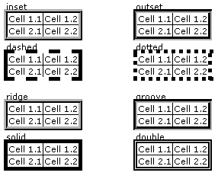
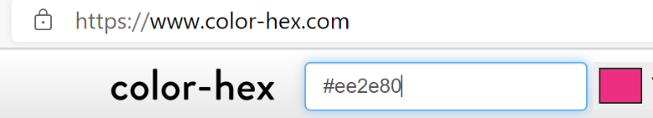
Examples of other box attributes:
Height : 300px;
Width: 400px;
Min-width: 75%;
Max-width: 100%;
Background-colour: #ee2e80;
Text-align: left;
Overflow: hidden;
Overflow: scroll;
Border-style: solid; (or: dotted, dashed, double, groove, ridge, inset, or outset).
Visibility: hidden;
box-shadow: 5px 5px 5px #777777;
border-radius: 10px;

Slide 55
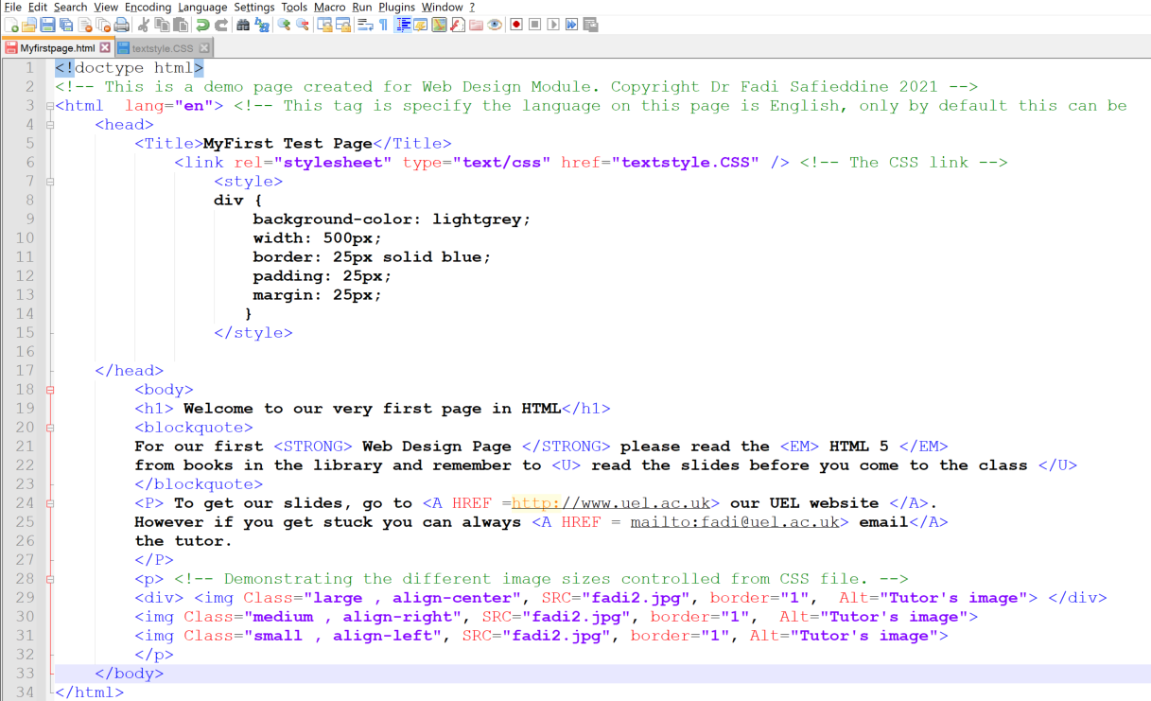
Demonstration of application
Notice I changed the width to 500px

Slide 56
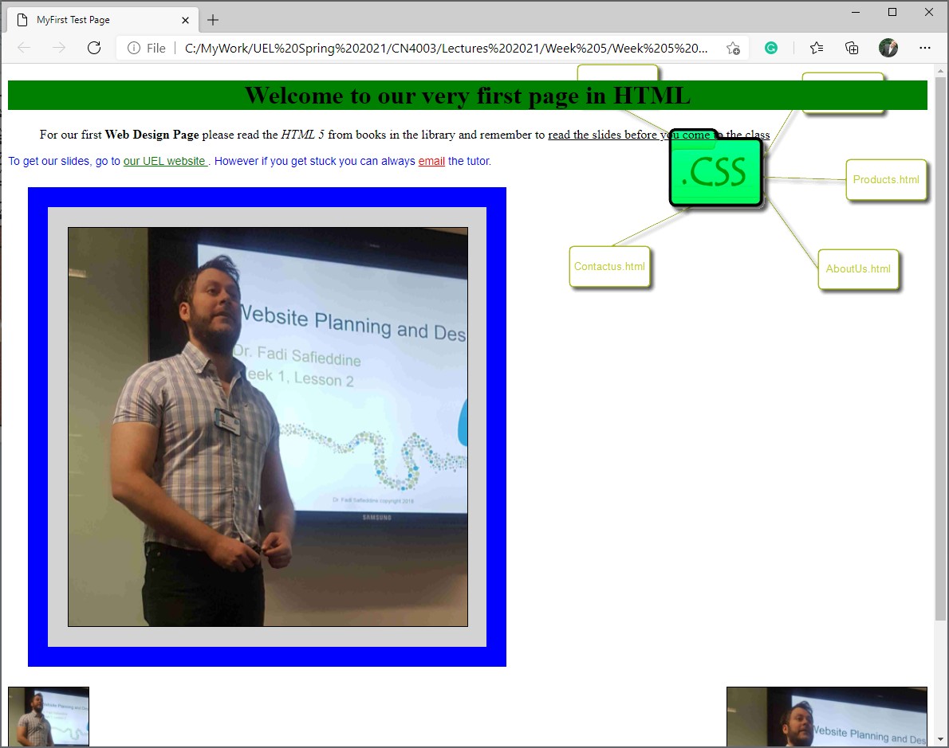
Demonstration of application

Slide 57
End of Part 4
Lab Practice 5.4. Follow these steps
And embed CSS to your page and pick any of the paragraphs or image to be boxed in a blue box.
Save the work.

Slide 58
What are HTML lists?
Part 5

Slide 59
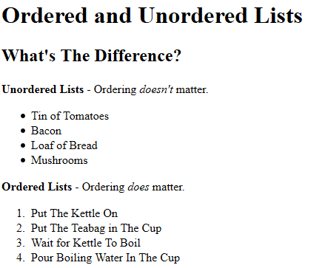
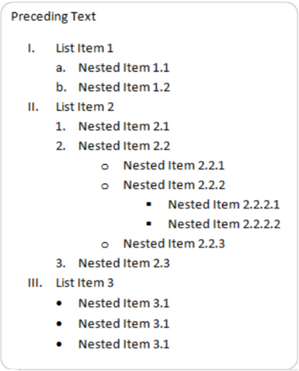
What are HTML lists?

Slide 60
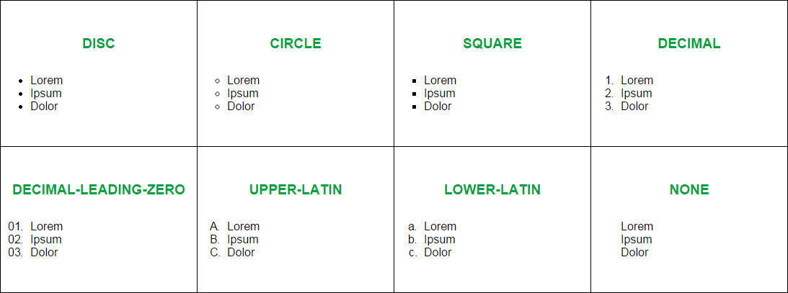
What are HTML lists?

Slide 61
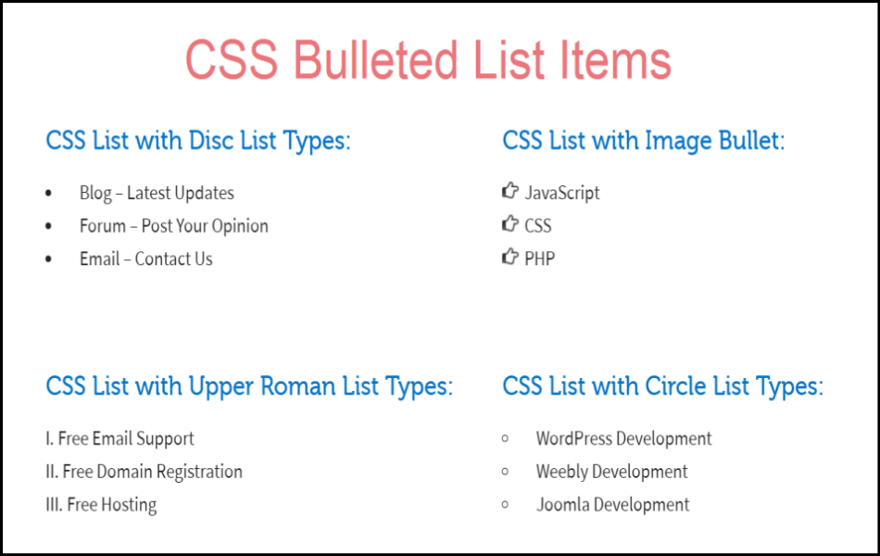
What are CSS lists?

Slide 62
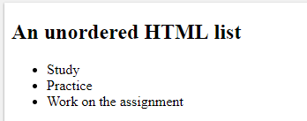
Unordered list:
<!DOCTYPE html>
<html>
<body>
<h2>An unordered HTML list</h2>
<ul>
<li>Study</li>
<li>Practice</li>
<li>Work on the assignment</li>
</ul>
</body>
</html>

Slide 63
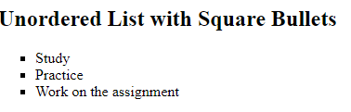
Unordered list:
<!DOCTYPE html>
<html>
<body>
<h2>An unordered HTML list</h2>
<ul style="list-style-type:square">
<li>Study</li>
<li>Practice</li>
<li>Work on the assignment</li>
</ul>
</body>
</html>
Other styles: disc, circle, or none.

Slide 64
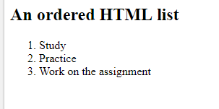
Ordered list:
<!DOCTYPE html>
<html>
<body>
<h2>An ordered HTML list</h2>
<ol>
<li>Study</li>
<li>Practice</li>
<li>Work on the assignment</li>
</ol>
</body>
</html>

Slide 65
Ordered list:
<!DOCTYPE html>
<html>
<body>
<h2>An ordered HTML list</h2>
<ol type="1">
<li>Study</li>
<li>Practice</li>
<li>Work on the assignment</li>
</ol>
</body>
</html>
Other types: A, a, I or i.

Slide 66
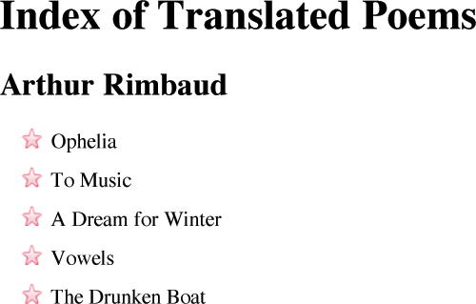
Adding image attribute of lists:
ul {list-style-image: url("star.png");}

Slide 67
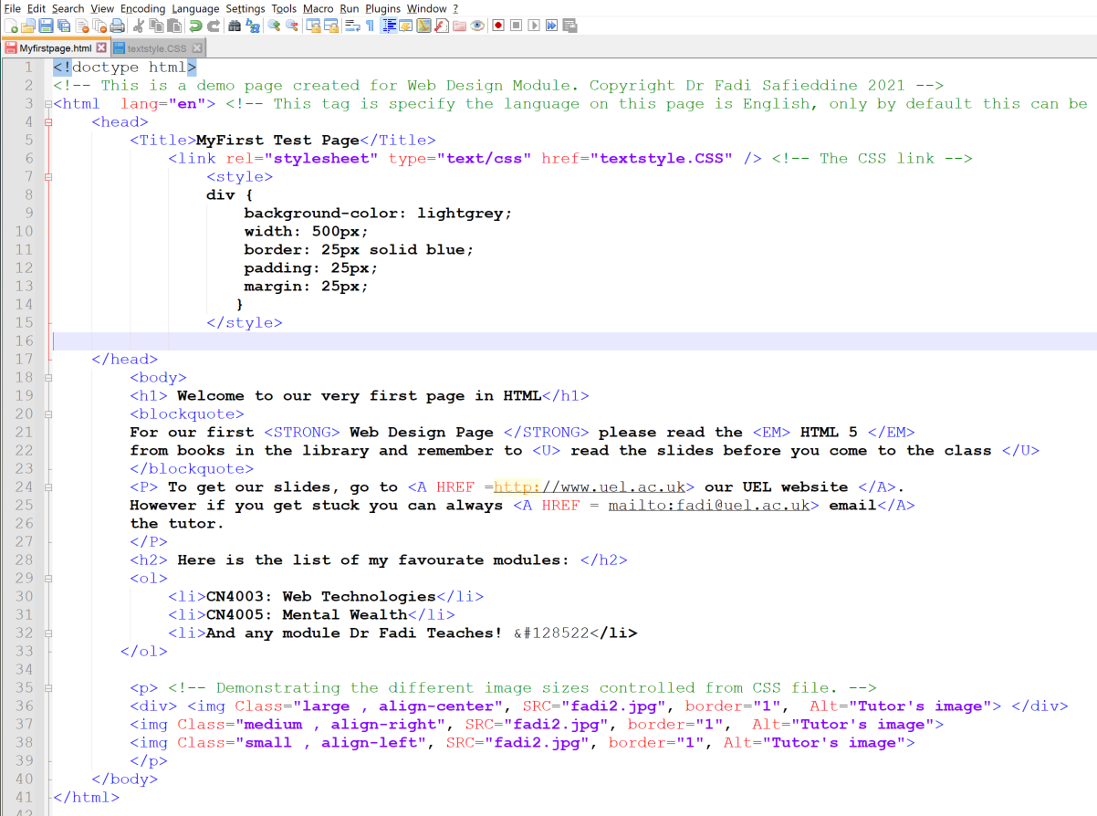
Demonstration of application
Note: &#128522 is HTML code for smiling Emoji

Slide 68
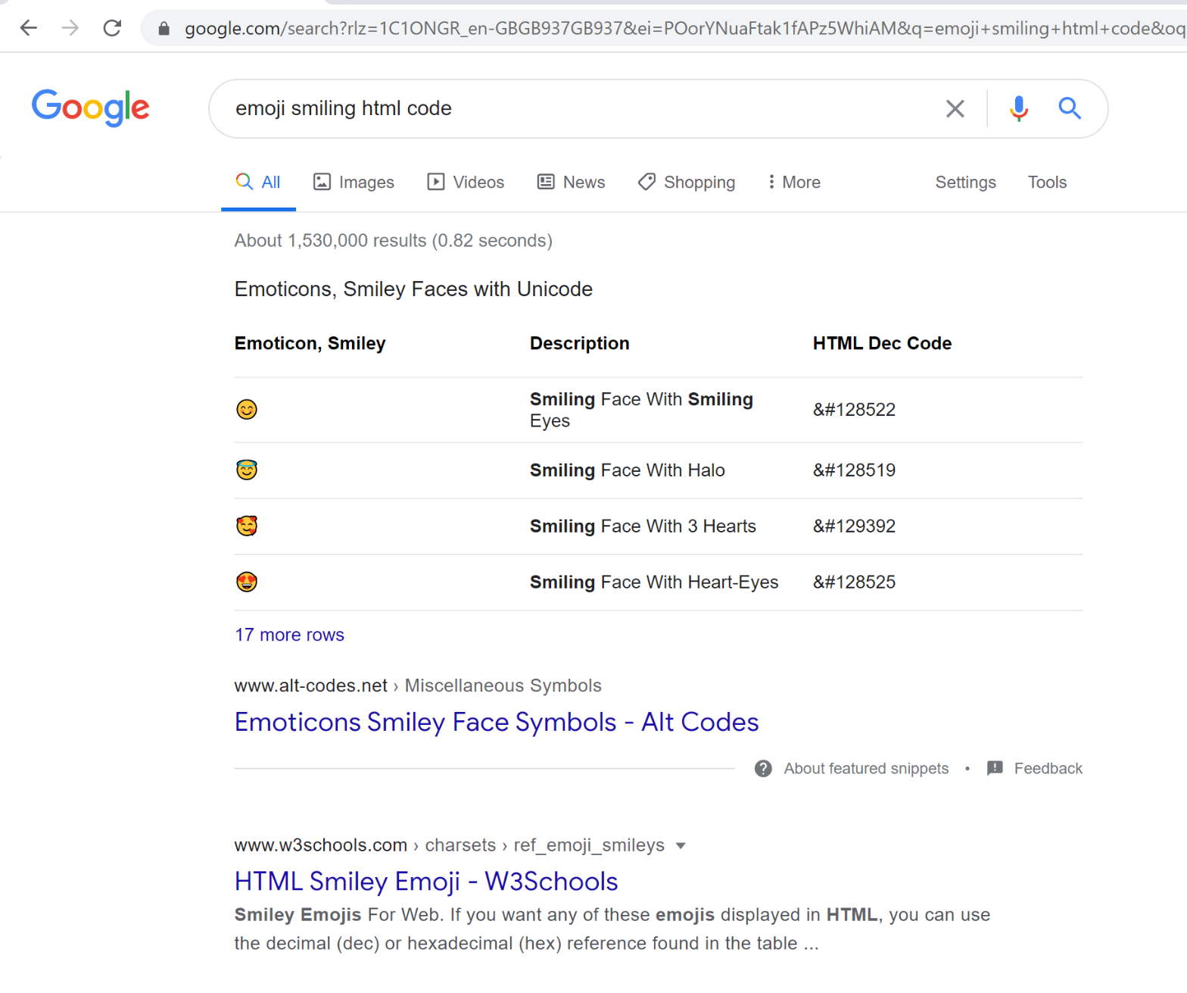
Demonstration of application
Note: &#128522 is HTML code for smiling Emoji

Slide 69
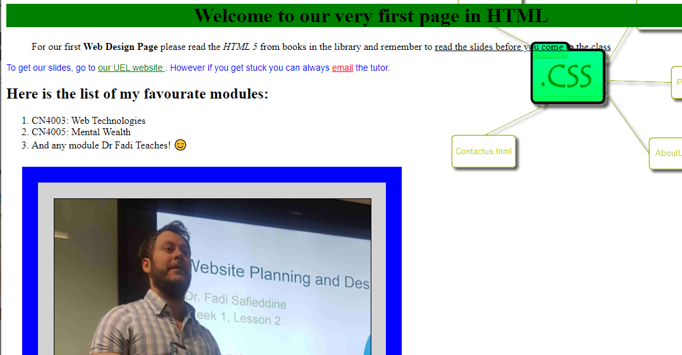
Demonstration of application

Slide 70
End of Part 5
Lab Practice 5.5. Create an order list of your favourite subjects so far.
Add the list to your Web page and save.

Slide 71
Additional Practice:
Part 6
Notes:
Shows how contrast between images and overlaid text affects readability.

Slide 72


Positioning images with background:
HIGH CONTRAST
LOW CONTRAST
SCREEN
unreadable
readable
readable
Notes:
Shows how contrast between images and overlaid text affects readability.

Slide 73
Home Practice
Research how you can have a div with different transparent background like image below:
HIGH CONTRAST
LOW CONTRAST
SCREEN
unreadable
readable
readable

Slide 74
Feedback
https://www.w3schools.com/css/css_image_transparency.asp

Slide 75
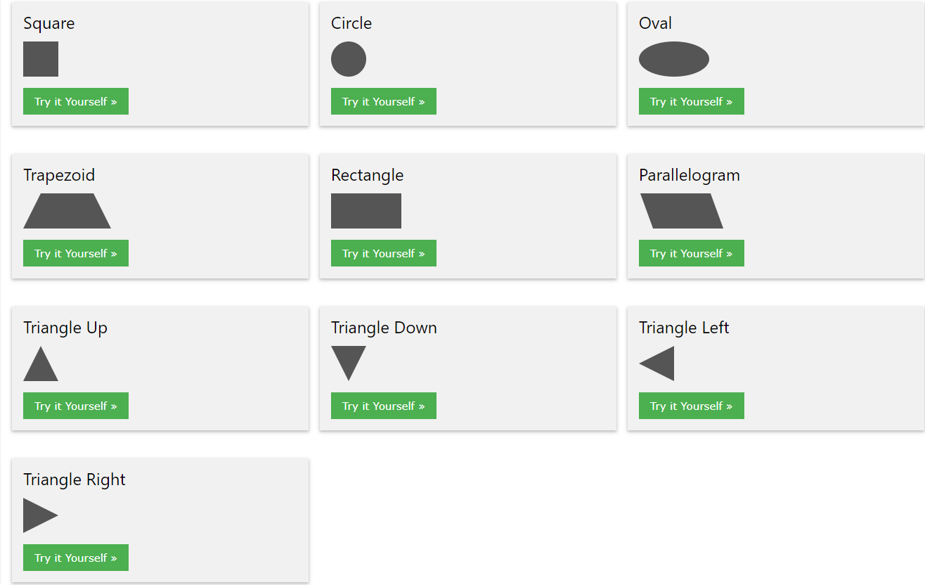
Home Practice:
Try these different shapes of boxes:
https://www.w3schools.com/howto/howto_css_shapes.asp

Slide 76
Talk about the assignment.
Review of the assignment
Q&A

